Slide 1
Survival Analysis and Cox Regression
Modeling Time to Event

Slide 2
Contents
01
02
Introduction to Survival Analysis
Time to Event and Censoring
03
04
Objective of Survival Analysis
Concept of Survival Function
05
06
Hazard Function
Cox Regression
07
08
Statistical Model
Case Study for Cox Regression

Slide 3

Introduction to Survival Analysis
Survival analysis is the study of time taken for an event to occur. This powerful statistical method allows researchers to analyze time-to-event data, accounting for incomplete observations.
The analysis variable represents the time between a time origin and an end point. The end point is either the occurrence of the event of interest, referred to as a death or failure, or the end of the subject's participation in the study.
Two functions are of fundamental interest—the survival function and the hazard function, which together provide a complete description of the time-to-event distribution.
One of the earliest applications of survival analysis was by Christiaan Huygens in 1669, demonstrating how many out of 100 people survive until 86 years of age.
The name ‘survival’ analysis stems from the usage of this method for modeling ‘time to death’; however the concept can be extended to several different areas and event can be defined as occurrence of a disease, lapse of a policy, etc.

Slide 4

Time to Event and Censoring
Consider that time to occurrence of an event T is a random variable. In order to define time-to-event, the following terms must be clearly defined:
Time Origin
Time Scale
Definition of an Event
The time origin must be specified such that individuals are as much as possible on an equal footing.
Usually, observation time is used as the time scale for both clinical and observational studies.
Based on the study objective, the event should be clearly defined.
Example: death, disease occurrence, relapse
Example: time point when treatment starts for a particular disease
Example: months, years, age
Key Relationship: If rate of occurrence of an event is λ then the expected time-to-event is 1/λ
Subjects are said to be censored in case of either of the following outcomes:
If they are lost to follow up
If they drop out of the study
If the study ends before they have an outcome of interest

Slide 5
Concept of Censoring
Censoring is a unique feature of survival data that distinguishes it from other statistical analyses. The outcome is represented by two variables:
Status Variable
Time Variable
ci = 1 if event occurred
ti = time at event, is a random variable having probability distribution
ci = 0 if no event by time t (Censored)
Status Variable
Study Opens
Study Closes
ci = 1 if event occurred
ci = 0 if no event by time t (Censored)
Event
Censored observation

Slide 6


Objectives of Survival Analysis
Survival analysis serves two primary purposes in statistical research:
Statistical Modeling
Statistical Inference
1. To estimate time-to-event for a group of individuals.
Eg. Time until recovery from low back pain
2. To assess the impact of factors/covariates on time-to-event
Eg. Age, Gender, Occupation and treatment
To compare time-to-event between two or more groups
Eg. Time until recovery from low back pain in active vs. placebo groups

Slide 7

Concept of Survival Function
The goal of survival analysis is to estimate and compare survival experiences of different groups.
Survival experience is described by the cumulative survival function:
Survival Function S(t)
S(t) = P(T > t)
= 1 - P(T > t)
= 1 - F(t)
F(t) is the Cumulative Distribution Function (CDF)
Example: If t = 40 years, S(t=40) represents the probability of surviving beyond 40 years. This is the
proportion of the population expected to survive past age 40.

Slide 8
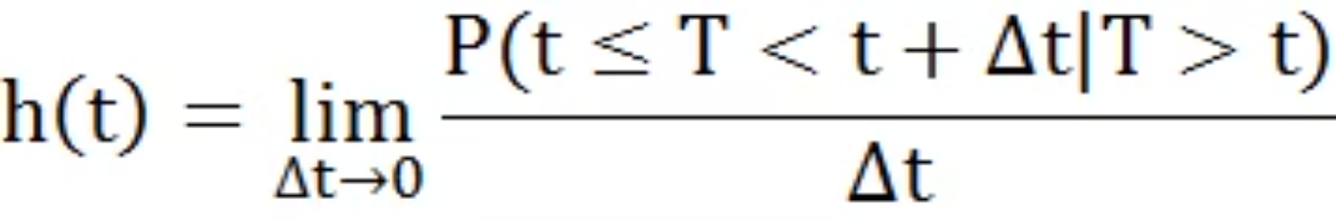
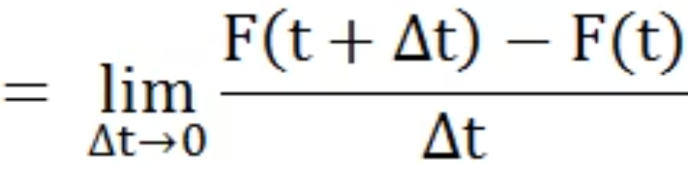
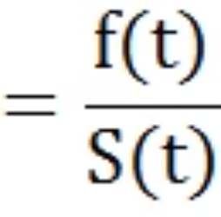
Hazard Function
Hazard Function (Instantaneous Failure Rate)
It is the ratio of conditional probability that the failure/death will occur in the interval t+Δt given that it has not occurred before time t, and width of the interval (Δt).
Hazard function where T is a random variable denoting 'Survival Time':

Slide 9



Hazard vs Density Function
Understanding the distinction between hazard and density functions is crucial for proper interpretation of survival analysis results.
Probability Density (Marginal Probability)
When one is born, there exists a certain probability of dying at any age; that is the probability density.
Example: A baby girl born today has, say, a 1% chance of dying at 80 years.
Hazard Function (Conditional Probability)
However, as one survives for a while, the probabilities keep changing based on having survived to that point.
Example: A woman who is 79 today has, say, a 5% chance of dying at 80 years.
The hazard function adjusts for survival experience up to time t, while the density function represents unconditional probabilities from the beginning of observation.

Slide 10
Cox Regression
Cox regression, also known as Cox proportional hazards regression, is a method for investigating the effect of several variables upon the time a specified event takes to happen.
DEPENDENT VARIABLE
INDEPENDENT VARIABLES
Time to Event
Categorical or Continuous
Time variable must be quantitative
Predictor variables that may influence the time to event (covariates)
Cox regression produces a survival function that predicts the probability of survival until time t for given values of the predictor variables.

Slide 11
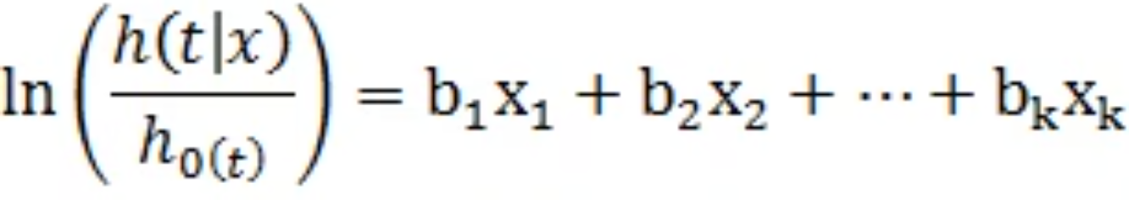

Statistical Model
The Cox proportional hazards model is expressed mathematically as follows:
where:
Cox Regression model is semi-parametric method
(No assumption about specific distribution but parametric form of the model)

Slide 12
Proportional Hazards Model
The proportional hazards assumption is the cornerstone of the Cox regression model. It states that the hazard ratio comparing any two individuals is constant over time.
Constant Hazard Ratio
1
For any two cases, the ratio of hazard functions at any time point remains constant throughout the observation period
Multiplicative Effect
2
Covariates have a multiplicative effect on the hazard function, meaning they scale the baseline hazard by a
constant factor
Model Interpretation
3
The exponential of regression coefficients (exp(β)) represents hazard ratios, indicating how risk changes with one-unit increases in predictors
Testing Assumptions
4
The proportional hazards assumption should be verified using statistical tests and graphical methods before final
interpretation

Slide 13
Case Study: Predicting Loan Defaulters
To predict whether the customer applying for the loan will be a defaulter and to identify early defaulters.
Sample size is 700
Independent Variables:
  Age group
  Years at current address
  Years at current employer
  Debt to Income Ratio
  Credit Card Debts
  Other Debts
Status and Time are used to create survival objects. Status =1 if customer defaulted before 36 months, and 0 if no default was observed in 36 months

Slide 14
Data Snapshot
BANK LOAN (COX)
SN | AGE | EMPLOY | ADDRESS | DEBTINC | CREDDEBT | OTHDEBT | STATUS | TIME
1 | 3 | 17 | 12 | 9.3 | 11.36 | 5.01 | 1 | 12
2 | 1 | 10 | 6 | 17.3 | 1.36 | 4 | 0 | 36
3 | 2 | 15 | 14 | 5.5 | 0.86 | 2.17 | 0 | 36
4 | 3 | 15 | 14 | 2.9 | 2.66 | 0.82 | 0 | 36
5 | 1 | 2 | 0 | 17.3 | 1.79 | 3.06 | 1 | 14
6 | 3 | 5 | 5 | 10.2 | 0.39 | 2.16 | 0 | 36

Slide 15
Data Description
BANK LOAN (COX)
Independent variables and Survival objects
Columns
Description
Type
Measurement
Possible values
AGE
Age Groups 1 (<28 years), 2(28-40 years), 3 (>40 years)
Factor
1,2,3
3
EMPLOY
No. of Years the Customer is Employed
Numerical
Years
positive value
ADDRESS
No. of Years the Customer is Staying at their Current Address
Numerical
Years
positive value
DEBTINC
Debt to Income Ratio
Numerical
-
positive value
CREDDEBT
Credit to Debt Ratio
Numerical
-
positive values
OTHERDEBT
Other Debt
Numerical
-
Positive value
STATUS
Whether the Customer Defaulted on the Loan (1) or 0 (Censored at 36 Months)
Binary
0,1
2
TIME
Indicates Time of 'Default'
Numerical
In months
positive value

Slide 16
Model Fitting
Interpretation:
The coef column gives the estimates of the parameters in the model.
Variable | Coef | Exp(Coef) | SE(Coef) | Z | Pr(>|z|)
AGE2 | 0.30668 | 1.35891 | 0.18701 | 1.640 | 0.1010
AGE3 | 0.54006 | 1.71611 | 0.25293 | 2.135 | 0.0327
EMPLOY | -0.24177 | 0.78524 | 0.02238 | -10.803 | < 2e-16
ADDRESS | -0.09825 | 0.90643 | 0.01634 | -6.011 | 1.84e-09
DEBTINC | 0.05859 | 1.06034 | 0.01308 | 4.478 | 7.53e-06
CREDEBT | 0.58482 | 1.79468 | 0.05020 | 11.649 | < 2e-16
OTHDEBT | 0.06465 | 1.06679 | 0.03166 | 2.042 | 0.0411

Slide 17
Individual Testing
Interpretation:
Except AGE2, all variables are significant and have an impact on time taken by a customer to default (p-values <0.05)
Higher the number of years spent at one address or employed, lesser is the probability to default (as the coefficients are negative)
Higher the amount of liabilities, higher is the probability to default (as the coefficients are positive)
Variable | Coef | Exp(Coef) | SE(Coef) | Z | Pr(>|z|)
AGE2 | 0.30668 | 1.35891 | 0.18701 | 1.640 | 0.1010
AGE3 | 0.54006 | 1.71611 | 0.25293 | 2.135 | 0.0327
EMPLOY | -0.24177 | 0.78524 | 0.02238 | -10.803 | < 2e-16
ADDRESS | -0.09825 | 0.90643 | 0.01634 | -6.011 | 1.84e-09
DEBTINC | 0.05859 | 1.06034 | 0.01308 | 4.478 | 7.53e-06
CREDEBT | 0.58482 | 1.79468 | 0.05020 | 11.649 | < 2e-16
OTHDEBT | 0.06465 | 1.06679 | 0.03166 | 2.042 | 0.0411

Slide 18
Predicted Probabilities
Interpretation:
Predicted probabilities that the customer will default before 24 months
AGE | EMPLOY | ADDRESS | DEBTINC | CREDEBT | OTHDEBT | Prob24
3 | 17 | 12 | 9.4 | 11.38 | 5.01 | 0.1262493
2 | 10 | 6 | 17.3 | 1.36 | 4.00 | 0.9341567
3 | 15 | 13 | 5.5 | 0.86 | 2.17 | 0.9957209
2 | 15 | 14 | 2.9 | 2.66 | 0.82 | 0.9930838
1 | 2 | 0 | 17.6 | 1.79 | 3.06 | 0.4630305
1 | 5 | 5 | 10.2 | 0.35 | 2.16 | 0.9416758

Slide 19
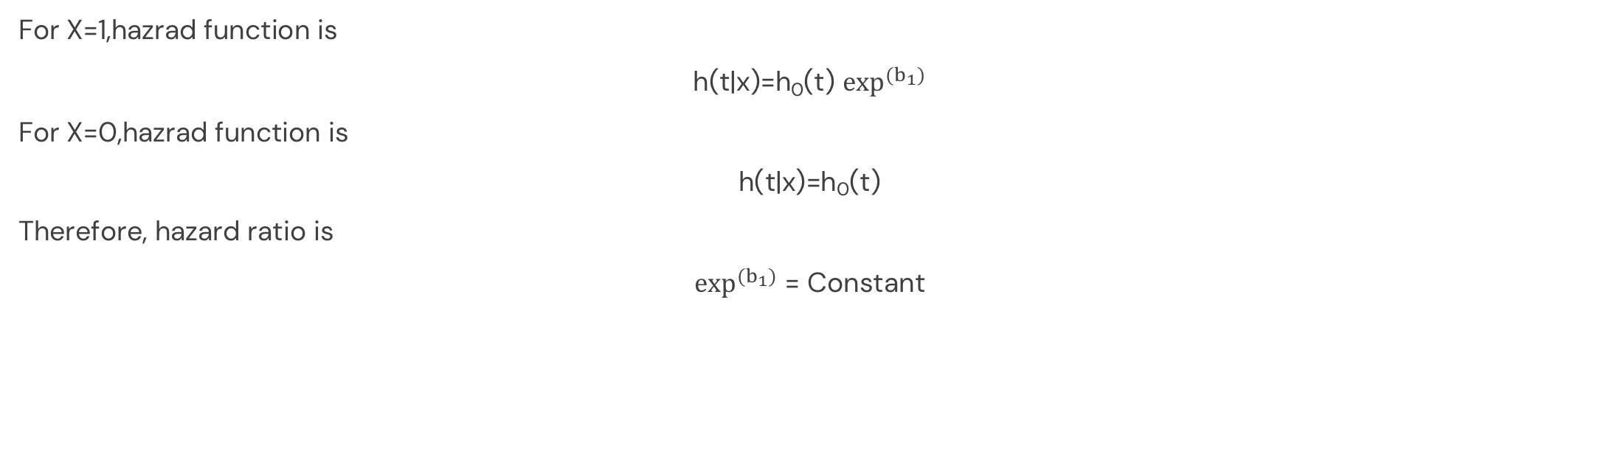
Proportional Hazards Model
For any two cases, the ratio of hazard function at any time point is constant
Consider simple example in which only independent variable is X=1 for group 1 and X=0 for group 2
For X=1,hazrad function is
h(t|x)=h₀(t) $\exp^{(b_{1})}$
For X=0,hazrad function is
h(t|x)=h₀(t)
Therefore, hazard ratio is
$\exp^{(b_{1})}$ = Constant

Slide 20
Quick Recap
Survival Analysis
Survival analysis is the study of time taken for an event to occur, accounting for censoring and incomplete observations
Cox Regression
Cox regression is used to model "Time to Event" variable while incorporating multiple predictor variables simultaneously
Cox Regression Model Fitting
coxph() from package survival fits a Cox regression. Survival Object is the response variable in coxph(). summary() of coxph() object returns Likelihood Ratio test results and p-values for checking variable significance
Predictions on New Data
predictSurvProb() from package pec generates predicted probabilities for new observations based on the fitted Cox model
Proportional Hazards Model
For any two cases, the ratio of hazard function at any time point is constant, which is the fundamental assumption of Cox regression

Slide 21
THANK YOU!

